Slide 1
SensusAccess
Tamara Mariotti, Coordinator of Accessibility Resources
Jocelyn Ireland, Instructional Design Librarian

Slide 2
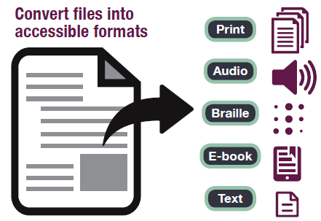
What is it?
Self-service, conversion tool
Converts PDF’s, JPEGS, PowerPoints, and other files into text files, MP3s, digital braille, EPUB, and more…

Slide 3
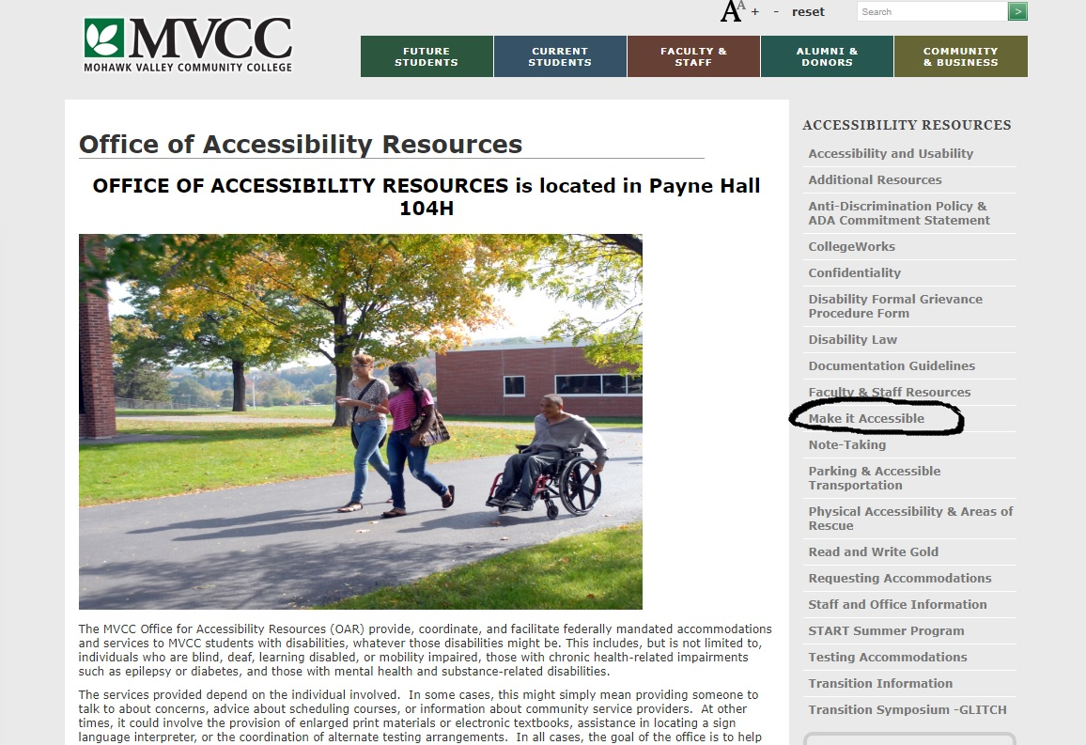
Where is it?

Slide 4
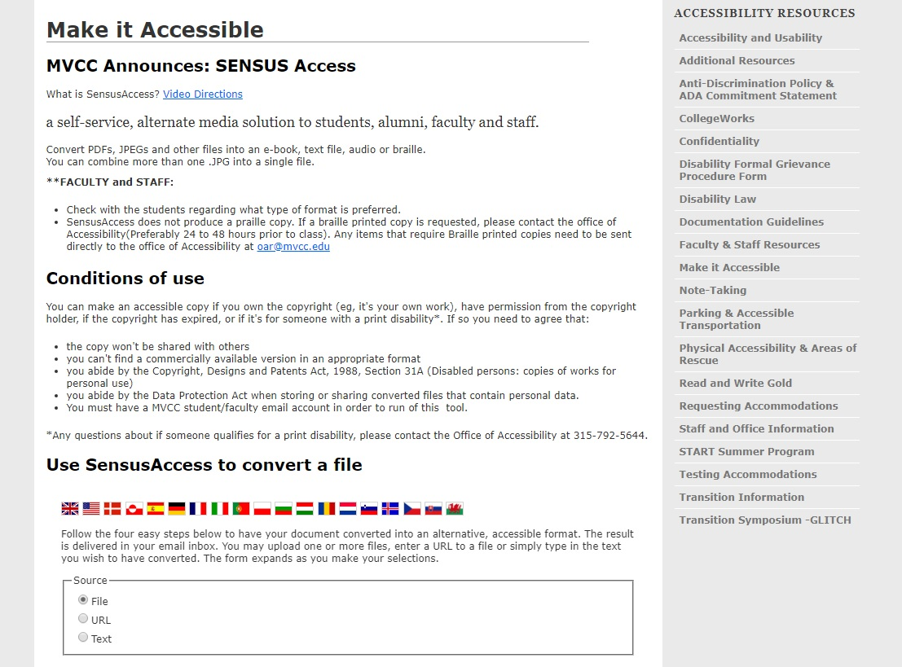
“Make it Accessible” webpage

Slide 5
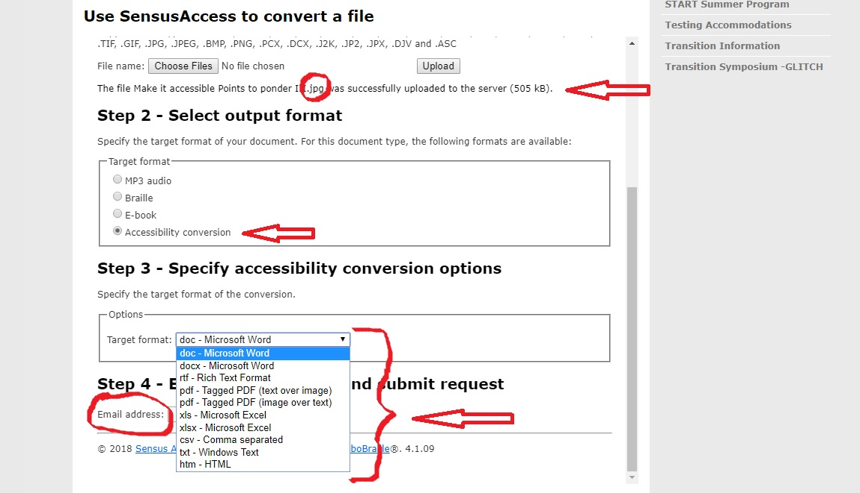
Demonstration: How to use it…

Slide 6
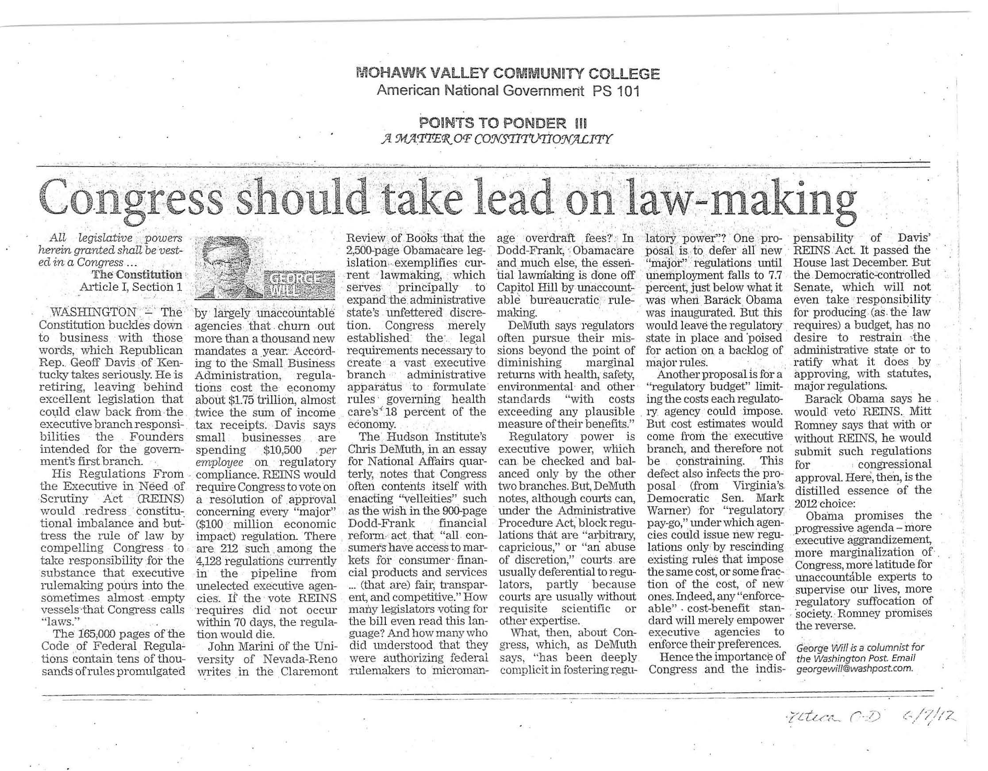
Demo- picture format (.JPG)

Slide 7
Sent back in 3 minutes to mvcc.edu email

Slide 8
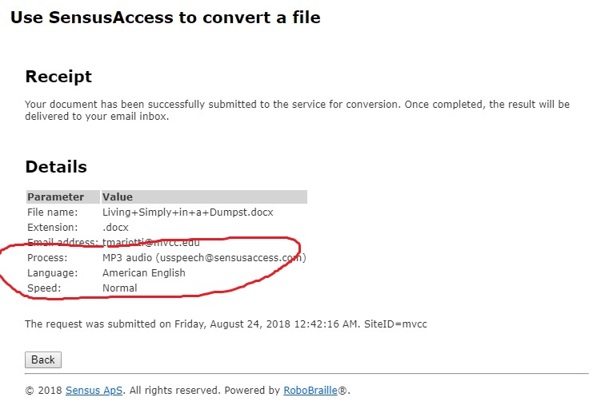
Demonstration 2: Docx to MP3 Audio file

Slide 9

Audio file – taken from EN101 Handout

Slide 10
Promote SensusAccess!!
Share it with students for preferred learning style needs
Offer alternate formats in Blackboard courses and the college website

Slide 11
Questions?
For more information contact:
Tamara Mariotti, Coordinator of Accessibility Resources (PH104H) tmariotti@mvcc.edu
315-731-5702
Jocelyn Ireland, Instructional Design Librarian (Learning Commons) jireland@mvcc.edu
  315-792-5372

