Slide 1
Mind, Meaning, & Maturity: The Science of a Fulfilling Retirement
Lorin Williams PsyD
Assistant Professor of Psychology
NYS Licensed Psychologist
Clinical Neuropsychologist

Slide 2
Intro & Disclosures
NYS Clinical Psychologist & Lifespan Neuropsychologist
Rewiring to Retiring Workshop Spring 2024
No disclosures

Slide 3
Learning Objectives
Demonstrate how meaningful retirement planning involves
clarity of goals,
self-reflection, and
a well-developed personal narrative around what retirement means to you
(not just when you will stop working)
Retirement is a spectrum, it is not binary

Slide 4
Despite all we know about the importance of preparing for retirement…
Roughly 4 in 10 adults in their 50s and early 60s have no retirement plan at all. Not even a rough sketch (Ekerdt, et al., 1996; Allianz Life Insurance Company of North America, 2024). Why???
Notes:
This goes far beyond finances. this reflects a gap in identity, narrative, and psychological readiness - Why is this a thing???

Slide 5
Retirement Planning Is Psychological, Not Just Practical
My take-aways:
Mental framing and cognitive readiness shape retirement outcomes.
Purpose and identity are crucial to successful transition.
Retirement today is fluid, complex, and longer, therefore requiring adaptive, flexible, and meaning-driven strategies.
My goal is to provide people with a biopsychosocial lens to understand and support this journey.

Slide 6
Step 1: Self-Assessment - What does wellness mean to you?
How would you define wellness?
BioPsychoSocial model
Nature vs Nurture & Epigenetics
Wellness & Transitions
Transitions = Stress (?)
How to thrive in transitions?
Notes:
Pg. 3 & 4

Slide 7
Top 3 Causes of Stress: Trauma, Life changes, Daily hassles
Effects of Stress: Increased cortisol weakens our immune system; stress contributes to the development of psychological disorders; can lead to heart disease, musculoskeletal, nervous system, and endocrine and metabolic disorders.
Ways to Cope: Problem-focused coping strategies; emotion-focused coping; & perceived control - greater perceived control improves mental and physical health
Notes:
Daily hassles may cause more stress related illness than life changes
Greater perceived control improves mental and physical health

Slide 8
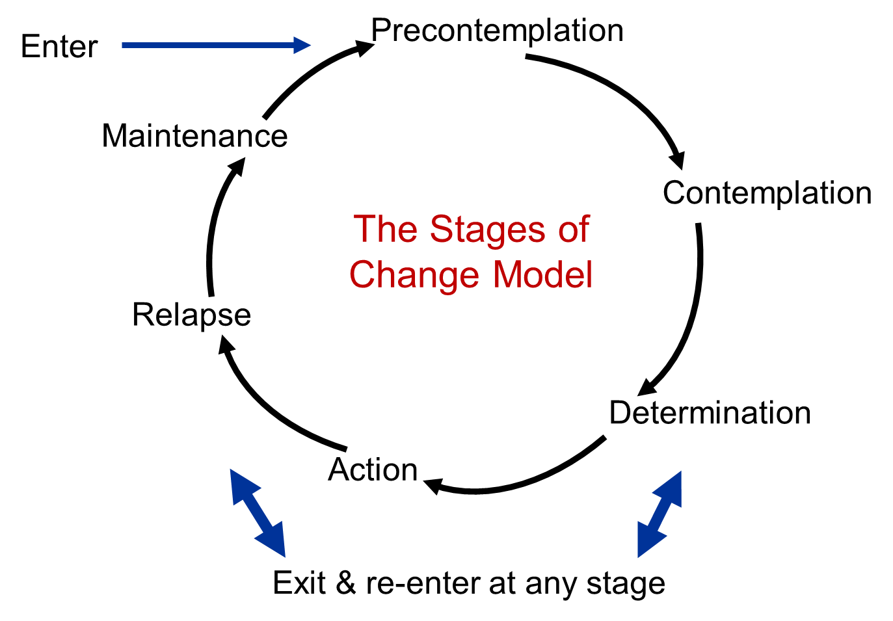
Stages of Change
Notes:
Originated in addiction, people struggling to quite substance use, funny enough, also applicable to people trying to quit working….

Slide 9
Stages of Change Activity
Wheel of Life Activity:
Which stage of change, overall, are you in?
Which state of change are you in for each domain?
Biological/Physical Health
Psychological/Emotional Health
Social/Connectivity Health
Financial Health
Rank which area you are the strongest in now.
Rank which area you are the weakness in now.
(1st, 2nd, 3rd, 4th etc.)
What does your current “wheel of life” circle look like?
Notes:
Pg. 5 & 6

Slide 10
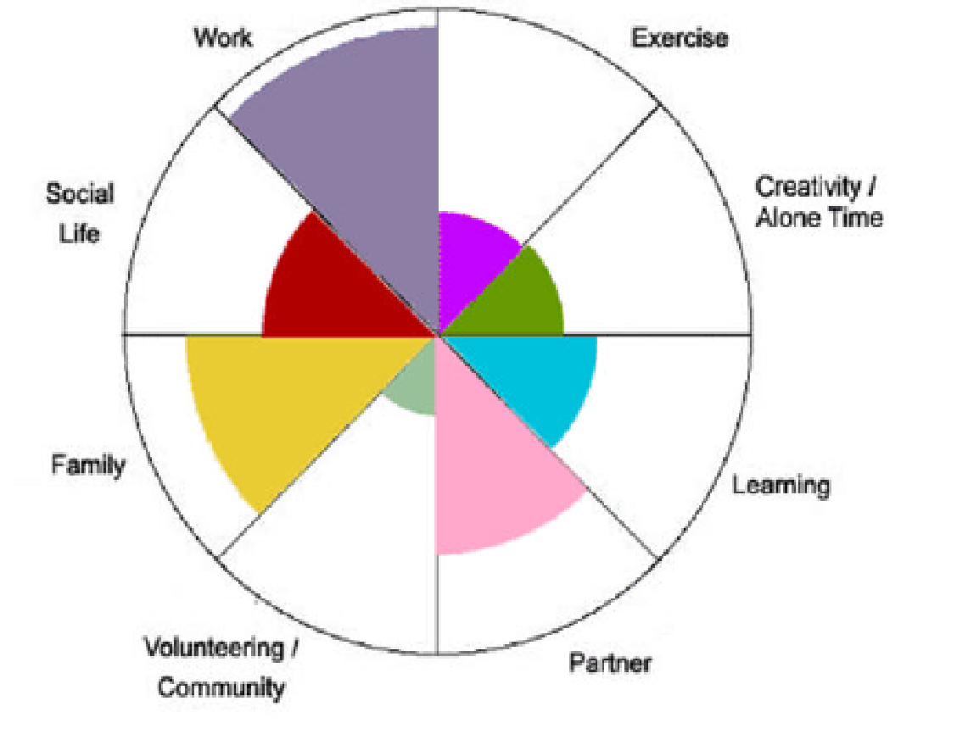
Wheel of Life
The eight sections in the wheel represent balance. If you regard the center as 0 and the outer edge as 10, you can rank your level of satisfaction with each life area by drawing a curved line to create a new outer edge.
Here is an example🡪

Slide 11
Blank Current Wheel of Life: Your life as it is now

Slide 12
Exploring Meaning
A few psychological theories from PY101…

Slide 13
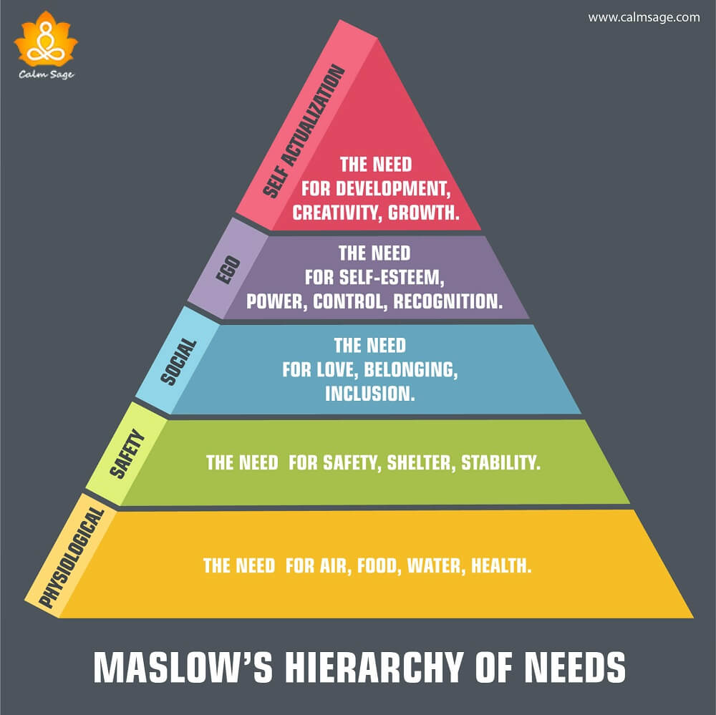
Maslow’s Hierarchy of Need

Slide 14
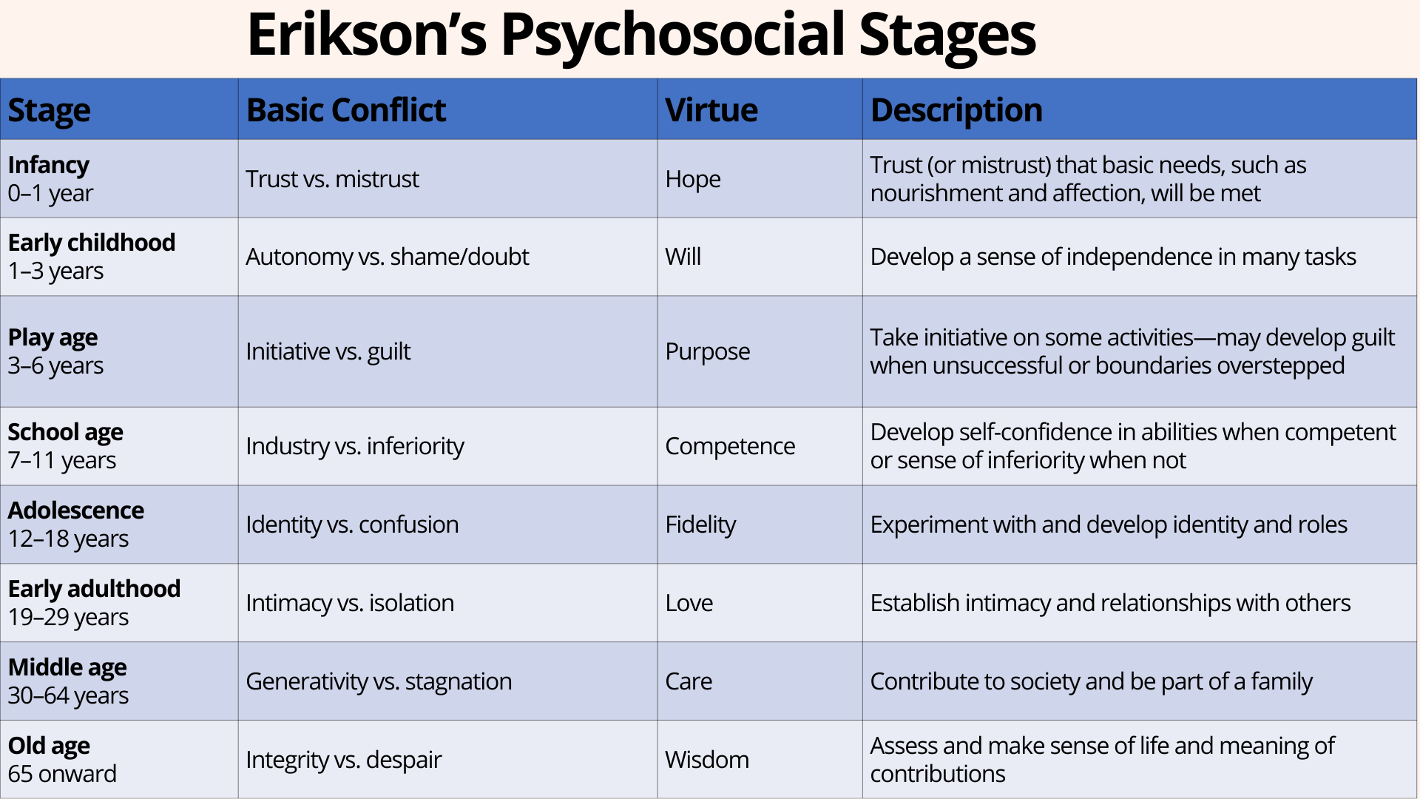

Slide 15
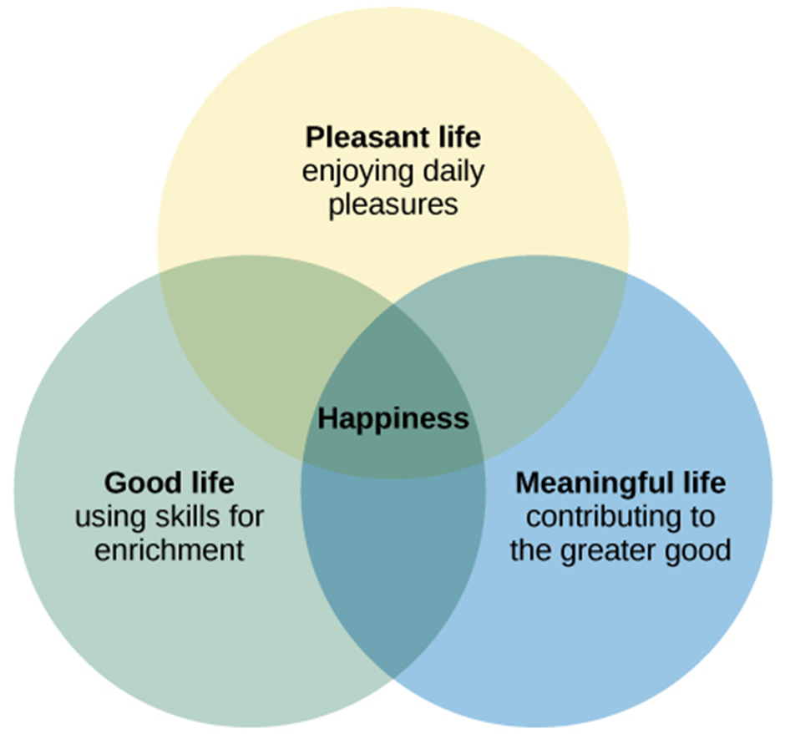
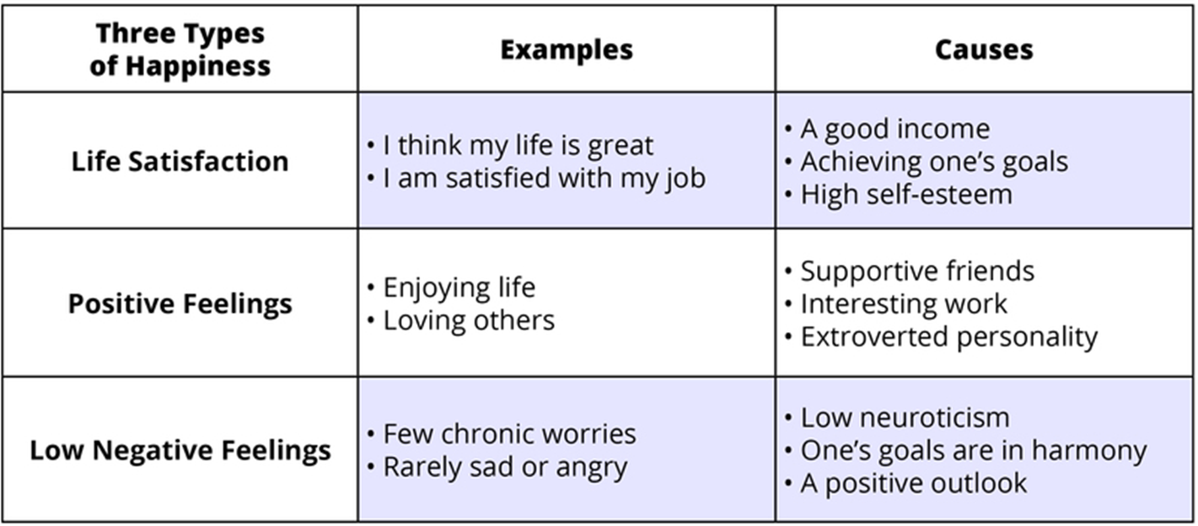
What is Happiness?

Slide 16
Factors Connected to Happiness
Happiness increases with age
Family and other social relationships
In the US well-being rises with annual income, but only up to $75,000
Education shows a weak positive correlation with happiness
Religiosity tends to improve happiness
People who have the characteristics that are highly valued by their culture tend to be happier
Attractiveness and Parenthood are NOT correlated with happiness

Slide 17
Now, to reflect on the meaning of being an “older adult”

Slide 18
Redefining “Elder”, for the present times
What are the first 5 words or phrases that come to mind when you think of “an old person”
- very fun exercise with students :)
Perception’s impact on biology
-7.5 years (Levy, et al., 2002; Levy, 2020)
Lifespan perspectives
Common views/myths
Realities of aging/statistics
Motivation for the greatness the next stage can hold
see notes below on “Economics of Aging” - many perceive an aging population as economic drag, but often 60+ are greatest contributors
Rejuvenation year = the new “gap year”
Statistics on changing demographics and lifespan
Positive aging: reboot, recharge, and reconnect
Wheel of Life: Wheel 2 – What is your ideal future wheel?
Notes:
- Beliefs about aging affect physical health, memory, recovery from disability, and even biomarkers for Alzheimer’s.
- Programs that enhance self-efficacy, purpose, and resilience also promote longevity and vitality.
Pg 7 Note to Lorin - Contrary to common myth, the older adult population generally is mobile, active, and healthy. Older adults also bring enormous social, intellectual, and economic capital to their communities. For example, of all the household income generated in New York State, 63 percent, more than $379 billion, is generated by older adults and baby boomers.
According to AARP, Inc., people over age 50 control 70 percent of the country’s wealth and make up 51 percent of consumer spending, more than $7 trillion. In New York, more than 935,000 individuals age 60+ contribute 495 million hours of community service annually at an economic value of $13.9 billion.

Slide 19
Blank Future Wheel of Life: Your life as you would like it to be

Slide 20
Brain Plasticity & Rewiring

Slide 21
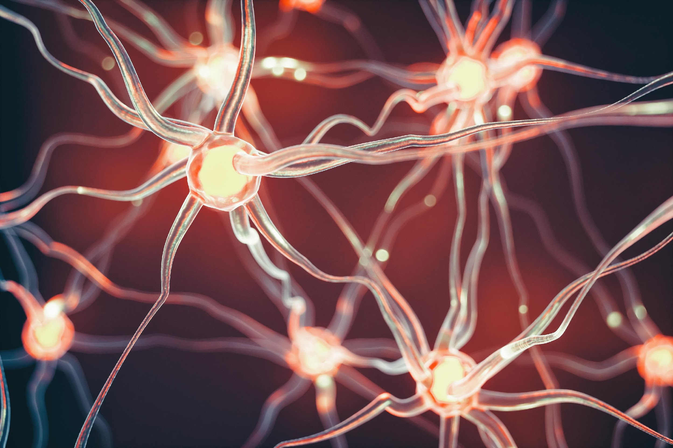
The state of brain science
Brain health
Biopsychosocial
Neuroplasticity
Sleep
Normal cognitive aging vs. mild cognitive impairment vs. dementia
Notes:
Pg. 12

Slide 22
Brain Recommendations
Cognitive
Social
Physical
Sleep
Psychological

Slide 23
Maturity & Consciously Curating Purpose

Slide 24
What is Your Purpose?
“Consciously curate” the 2nd half of your life
Making investments into new kinds of assets for a richer life
Activation
Executive functioning: planning & organization
Ability/Locus of Control
Ability Worksheet
Purpose & Investments
Wellness/biological
Community/social
Physical/biological
Reasons Worksheet
Need Worksheet
Notes:
Pg. 14, 15, 16
Introduce this in the beginning as the overarching goals, and then bring it back at the end after this as reflection
Stronger connection between all the didactic pieces and the final piece

Slide 25
Thinking Ahead: Flexible, Reflective, and Purposeful
Retirement is not just a financial decision—it is a cognitive process requiring identity shifts/flexibility, planning, and self-regulation (Kerry, 2018).
More evidence that mental models about retirement shape how people prepare for and adjust to it (like Topa & Alcover).
Emphasize the need for cognitive tools—like reframing, goal-setting, and reflective thinking—to prepare the mind for change.
Key question - “What does this next chapter allow me to become?”
Notes:
This research reinforces our need to treat retirement not as a stop, but a transition that begins in the mind. When we help people think differently, they plan differently, and live more meaningfully.
As retirement becomes a moving target, our real task isn’t to create a checklist. It is to help people write a meaningful next chapter of their life story.
In a 2015 study by Topa and Alcover, they found that how people feel about their ability to retire, not just how much money they have, can significantly influence both their intention to retire and how well they adjust afterward. One of the strongest predictors of a happy retirement? Self-efficacy: believing you can handle the transition. That belief, along with maintaining a sense of identity and avoiding negative comparisons with others, sets the stage for the ‘Maturity Mindset’. A blend of confidence, continuity, and contentment.

Slide 26
Maturity & Being a “Modern Elder”
Maturity is an evolving process: the ability to navigate transition, ambiguity, and reinvest wisdom in new roles.
True maturity in retirement is about adaptation, resilience, and a mindset that allows us to grow into new identities, rather than shrink from the loss of old ones.”
Link this to psychological maturity: generativity (Erikson), post-formal thinking, adaptability, and proactivity.

Slide 27
Psychosocial Factors in Retirement (Topa & Valero, 2017; Topa & Alcover, 2015)
High retirement self-efficacy predicts both retirement satisfaction (Topa & Valero, 2017).
Older worker identity supports smoother retirement adjustment.
Relative deprivation reduces satisfaction and increases partial/late retirement intentions (Topa & Alcover, 2015).
Foster confidence and self-efficacy to support a smoother transition.
View retirement as a purpose-driven chapter, not a conclusion.
Cultivate gratitude and avoid unhelpful comparisons with others.

Slide 28
Modern Retirement Checklist
Know your why: Define your purpose
Create a life rhythm: Balance activity and rest
Stay connected: Relationships = resilience
Plan practically: Paperwork matters (power of attorney, MOLST, health care proxy, will, etc.)
Keep growing: Curiosity is longevity fuel
Synergy: The power of additive practices (iPACES)

Slide 29
Continued Growth and Additional Resources
New York State Office of Aging
Training | Office for the Aging (ny.gov)
Advanced Care Directives Guide: https://www.health.ny.gov/publications/1503.pdf
o Health Care Proxy: https://www.health.ny.gov/publications/1430.pdf
https://aging.ny.gov/programs/medicare-and-health-insurance
How to Find a Financial Planner
• Local Area Search for CFPs: https://www.letsmakeaplan.org/
• NYS Office for the Aging: https://aging.ny.gov/programs/medicare-and-health-insurance
• Medicare Website: https://www.medicare.gov/
medicare.gov/basics/get-started-with-medicare/using-medicare/helpful-tools
• Medicaid Information: https://www.medicaid.gov/medicaid/eligibility/seniors-
medicare-and-medicaid-enrollees/index.html
• Medicaid NY Contact: https://www.medicaid.gov/about-us/where-can-people-get-
help-medicaid-chip/index.html#NY
• VA Healthcare: https://www.va.gov/health-care/
• Health Insurance Marketplace: https://www.healthcare.gov/
Social Security Resources
• Benefit Calculator: https://www.ssa.gov/benefits/calculators/
• MySocialSecurity Account Creation/Login: https://www.ssa.gov/myaccount/
Gallup Strengths Assessment
https://www.gallup.com/cliftonstrengths/en/252137/home.aspx
https://www.mvcc.edu/strengths/strengths-assessment.phpd
Chip Conley
Books
Wisdom at Work (2018)
Learning to Love Midlife (2024)
Modern Elder Academy
https://www.meawisdom.com/
Brain Health
Dr. Michelle Braun: Neuropsychologist whose book is a science-based program to sharpen memory and reduce risk of Alzheimer's
https://www.drmichellebraun.com/
Book: High-Octane Brain
Positive Aging
Dr. Becca Levy: Yale professor and leading expert on the psychology of successful aging.
https://becca-levy.com/
https://ysph.yale.edu/about-school-of-public-health/communications-public-relations/publications/public-health-magazine/article/becca-levy-and-the-fight-against-ageism/
YMCA of the Greater Tri-Valley
https://www.ymcatrivalley.org/
Mohawk Valley Institute for Learning in Retirement
https://www.mvcc.edu/mvilr/

Slide 30
References
Allianz Life Insurance Company of North America. (2024, March 6). Nearly half of Americans expect slow transition into retirement [Press release]. https://www.allianzlife.com/about/newsroom/2024-Press- Releases/Nearly-half-of-Americans-expect-slow-transition-into-retirement
Braun, M. (2020). High-Octane Brain: 5 Science-Based Steps to Sharpen Your Memory and Reduce Your Risk of Alzheimer’s.
Conley, C. (2018). Wisdom at work: The making of a modern elder. Currency.
Conley, C. (2024). Learning to love midlife: 12 reasons why life gets better with age. Little, Brown Spark.
Kerry, M. J. (2018). Psychological antecedents of retirement planning: A systematic review. Frontiers in Psychology, 9, 1870. https://doi.org/10.3389/fpsyg.2018.01870
Levy, B. R., Slade, M. D., Kunkel, S. R., & Kasl, S. V. (2002). Longevity increased by positive self-perceptions of aging. Journal of Personality and Social Psychology, 83(2), 261–270. https://doi.org/10.1037/0022- 3514.83.2.261
Levy, B. (2022). Breaking the age code: How your beliefs about aging determine how long and well you live. William Morrow.
Lumen Learning. (n.d.). Introduction to psychology (Waymaker ed.). https://courses.lumenlearning.com/waymaker-psychology/
Topa, G., & Alcover, C.-M. (2015). Psychosocial factors in retirement intentions and adjustment: A multi-sample study. Career Development International, 20(4), 384–408. https://doi.org/10.1108/CDI-09-2014-0129
Topa, G., & Valero, E. (2017). Preparing for retirement: How self-efficacy and resource threats contribute to retirees' satisfaction, depression, and losses. Journal of Occupational and Organizational Psychology, 90(3), 688–710.

