Slide 1

Departmental website ADA Review for Title II
For CMS Users and Reviewers

Slide 2
AGENDA
What am I responsible for?
What should I be reviewing?
Web Accessibility Highlights
PDF Documents
How to Report Issues
Resources and Further Reading

Slide 3
What am I responsible for:
Your department/school/office’s website or Managing Sections (for CMS Users)
Try multiple Google searches
The Compliant Office might be able to assist you on coming with the review list

Slide 4
What should I be reviewing:
Main Content Region
Left Side Navigation
PDF/ Downloadable Documents
What is not in the Main Content Region?
Site Header and Footer
Main Content region starts below the gradient green bar with Heading 1

Slide 5
Headings
Use Chrome Extension to check Headings and Page Reading Order
Heading Tag Markup
HeadingsMap
Highlight HTML Headings
Check nested heading structure
Check relevance of H1 against page content
There should only be a single H1 on a page
To change the default H1, check out to the page, then make sure under Properties tab
Main content region begins with H2 headings
Notes:
Web visitors might rely on heading for Navigation Purposes. Headings should help screen reader users scan the page. headings should follow a true hierarchy, not just appear in order. Might need content rewrite to achieve such structure, especially for pages without headings and are lengthy
Example: https://www.mvcc.edu/academics/health-sciences/nursing/index.php

Slide 6
Headings (continued)
Use headings in a logical hierarchy
H2 = major sections
H3 = subsections under that H2
H4 = subsections under that H3
Do not use different headings for design purposes
Do not bold normal text and treat it like a heading
Do not skip heading orders (Eg: H1 to H3 without H2 is not good)
H1 → paragraph text (Eg: a short intro) → H2 is normal and accessible

Slide 7
Links
Link text should clearly describe the destination or action
Avoid vague link text
“Click here,” “Read more,” and “More” are not enough on their own
Do not paste long raw URLs as link text
Check for broken links
Linked text should be meaningful but concise
Avoid linking entire long paragraphs
Do not force users to guess where a link will go

Slide 8
Images / alt text
How to check:
Use Alt Text Viewer (Chrome Extension) Or In Edit Mode (For CMS Editor)
Informative images need concise but meaningful alt text
Missing alt text should be reviewed and fixed
Alt text should communicate the purpose or meaning of the image
Do not write alt text based only on what the image looks like
If nearby text already says the same thing, avoid repeating it in alt text
Images that contain important text should be avoided
Real text on the page is better than text inside an image
Image with lengthy text embedded should be removed
Complex images may need more than short alt text
Charts, graphs, infographics, maps, and diagrams may need nearby explanation
Background images usually do not have alt text, so make sure important meaning is not only shown in the background image
Icons are fine, but do not rely on icons alone to communicate meaning

Slide 9
Color contrast
Make sure text is easy to read against the background
Do not use color alone to convey meaning
Be careful when placing text over images
Avoid light text on light backgrounds or dark text on dark backgrounds
Check custom-colored text, buttons, and banners carefully

Slide 10
Tables
Use tables only for real data
Do not use tables just to control layout or spacing
Make sure the table has clear row and column headings
Keep the table simple and easy to follow
Avoid merged cells when possible
Every data cell should make sense with its heading
If the table is too complex, consider breaking it into simpler tables
If a table is hard to understand visually, it will likely be hard to understand accessibly too
Notes:
Examples: https://mvcc.edu/business-office/tuition-and-fees.php vs. https://mvcc.edu/housing/costs.php

Slide 11
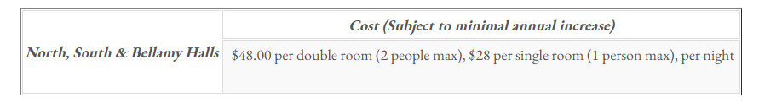
Examples:

Slide 12
Tables
Use tables only for real data
Do not use tables just to control layout or spacing
Make sure the table has clear row and column headings
Keep the table simple and easy to follow
Avoid merged cells when possible
Every data cell should make sense with its heading
If the table is too complex, consider breaking it into simpler tables
If a table is hard to understand visually, it will likely be hard to understand accessibly too

Slide 13
PDFs
An accessible PDF is a PDF that is structured so all users, including screen reader and keyboard users, can understand and navigate it.
Reviewers should flag PDFs that are:
scanned
hard to read
poorly structured
image-based
long forms
full of tables

Slide 14
Exporting from Word to PDF
Use one main Heading 1 for the PDF document title, even if the PDF has multiple pages; new pages do not usually mean new H1 headings.
When creating the word documents that will be exported to the web:
Use built-in heading styles, modify style as needed
Use real lists and simple tables
Add meaningful alt text to images
Use descriptive link text
Keep reading order clear and simple
Avoid text embedded in images
Do not use Text Box
Run Word’s Accessibility Checker before exporting

Slide 15
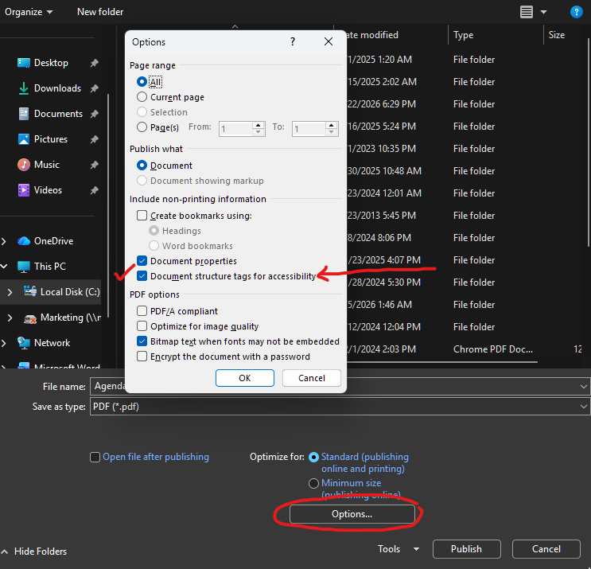
Exporting to a PDF
Use File > Export > Create PDF/XPS Document
Under Options > Make sure Document structure tags for accessibility is checked

Slide 16
Captions for videos
Videos with speech should have accurate captions
Captions should include important spoken content
Auto-captions should be reviewed for accuracy
Do not rely on audio alone to deliver important information
If a video has no sound, make sure important visual information is explained nearby

Slide 17
Embedding Video on a Webpage
Make sure the video has accurate captions
Make sure the video embed has a clear title or context on the page
A clear heading or descriptive text above the YouTube embed can serve as the video’s title/context
Do not rely on the video alone to provide critical information
Check that the video still works well on mobile and smaller screens

Slide 18
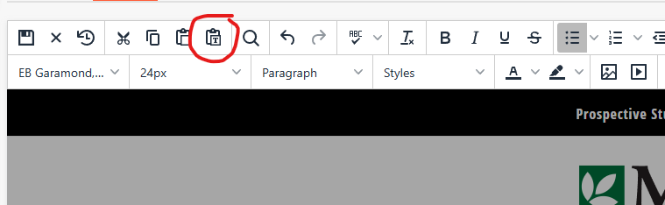
Few More Points for Editors
Before copying and pasting text from MS Office, enable “Paste as text” on the CMS Text Editor

Slide 19
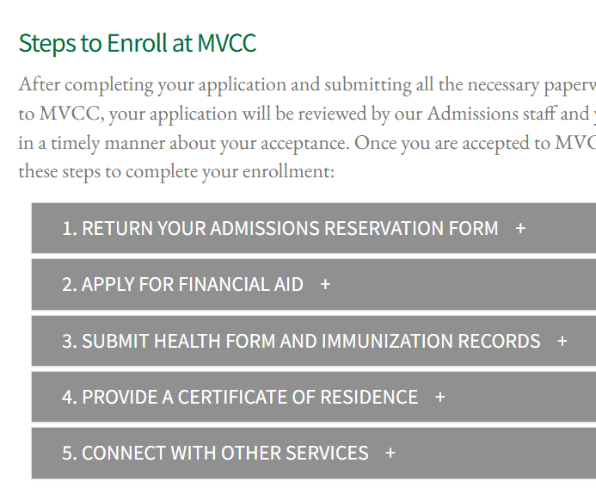
More Points for Editors
Using CMS Snippets like Accordions (For example: FAQs or Steps), the button text is tagged as H3 and can’t be changed. So adjust your content to work with them accordingly.

Slide 20
How to Report Issues
Submit Reporting ADA Issues document if you are not an editor
Ask your editor to make the changes
Inform other offices when you notice issues outside of your area
If you notice something that needs archiving, contact Marketing

Slide 21
Resources and Further Reading
Today’s Presentation
Web Accessibilty https://mvcc.edu/web-accessibility
Web Accessibilty Quick Guide https://mvcc.edu/web-accessibility/guide

